Slide 1


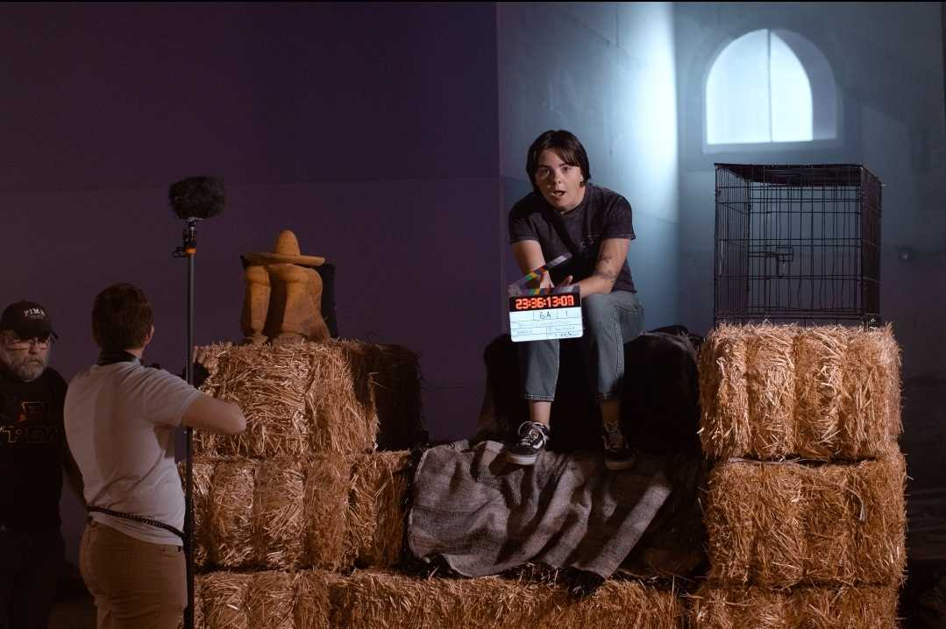
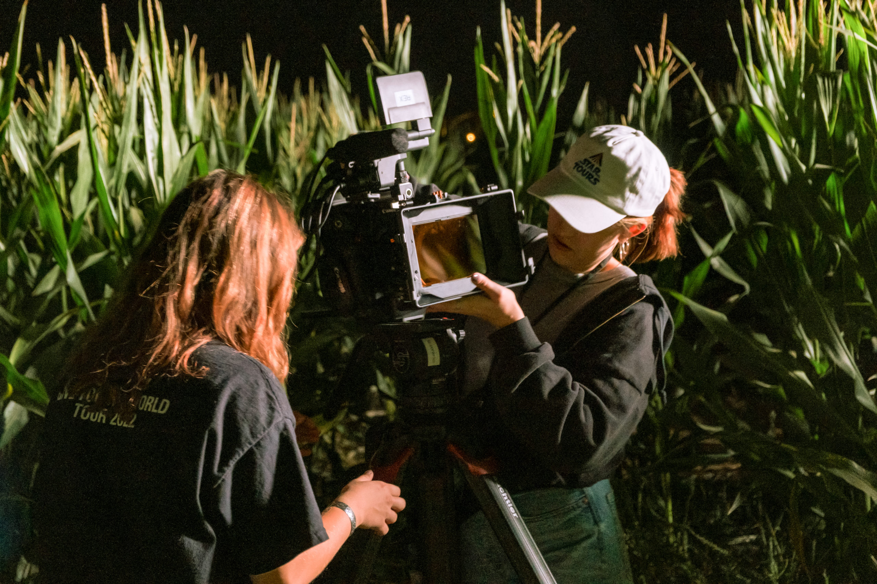


SCHOOL OF THEATRE,
FILM & TELEVISION

Slide 2
Welcome!
Hannah Meyer & Jessica Maerz
Academic Advisors
Daniela Tascarella
Student Academic Specialist

Slide 3


What will I learn?
  Film & Television Studies
    Film/Television criticism, analysis, writing
    Courses include the study of history, genres, cultures, screen artists (directors, producers)
  Producing
    Business end of film/TV industry (project development)
    Courses include developing ideas for film & TV, producing a script, distribution and promotion, U.S. and global film and TV industries
  Film & Video Production
    Hands-on independent filmmaking

Slide 4


What does Film & TV NOT include?
Film & Television at UA offers classes in
film, video and television.
We do NOT offer programs in:
  Radio
  Acting (BFA Theatre Production)
  Web design
  Photography (School of Art)
  Graphic design (School of Art)
  Audio production
  Digital animation (School of Art)
  Television production
  Broadcast journalism
  Set design/Construction (BFA Theatre Production)

Slide 6
I want to apply to the BFA.
Anyone attending these information sessions are NOT eligible to apply straight into the BFA program.
All new incoming students to the FTV program will first start out in the BA.
Foundational courses are required for BOTH degrees and start out the same.
There is no expedited way to enter into the BFA.
You are not eligible to apply until you’ve completed 4/5 FTV foundation courses. (Sophomore year OR after 1 year).
If you would like more information, please review the website.

Slide 9
Advanced Standing in Film & TV
(Required to register for 300/400 level Film & TV Courses)
  At least 2.5 overall UA GPA
    Strictly enforced
  Completion of the Film & TV core courses (FTV 100A, 100B, 200, 210, 270)
  Completion of at least 40 total units
Your advisor is
always here
if you
ever
have any
questions!

Slide 10
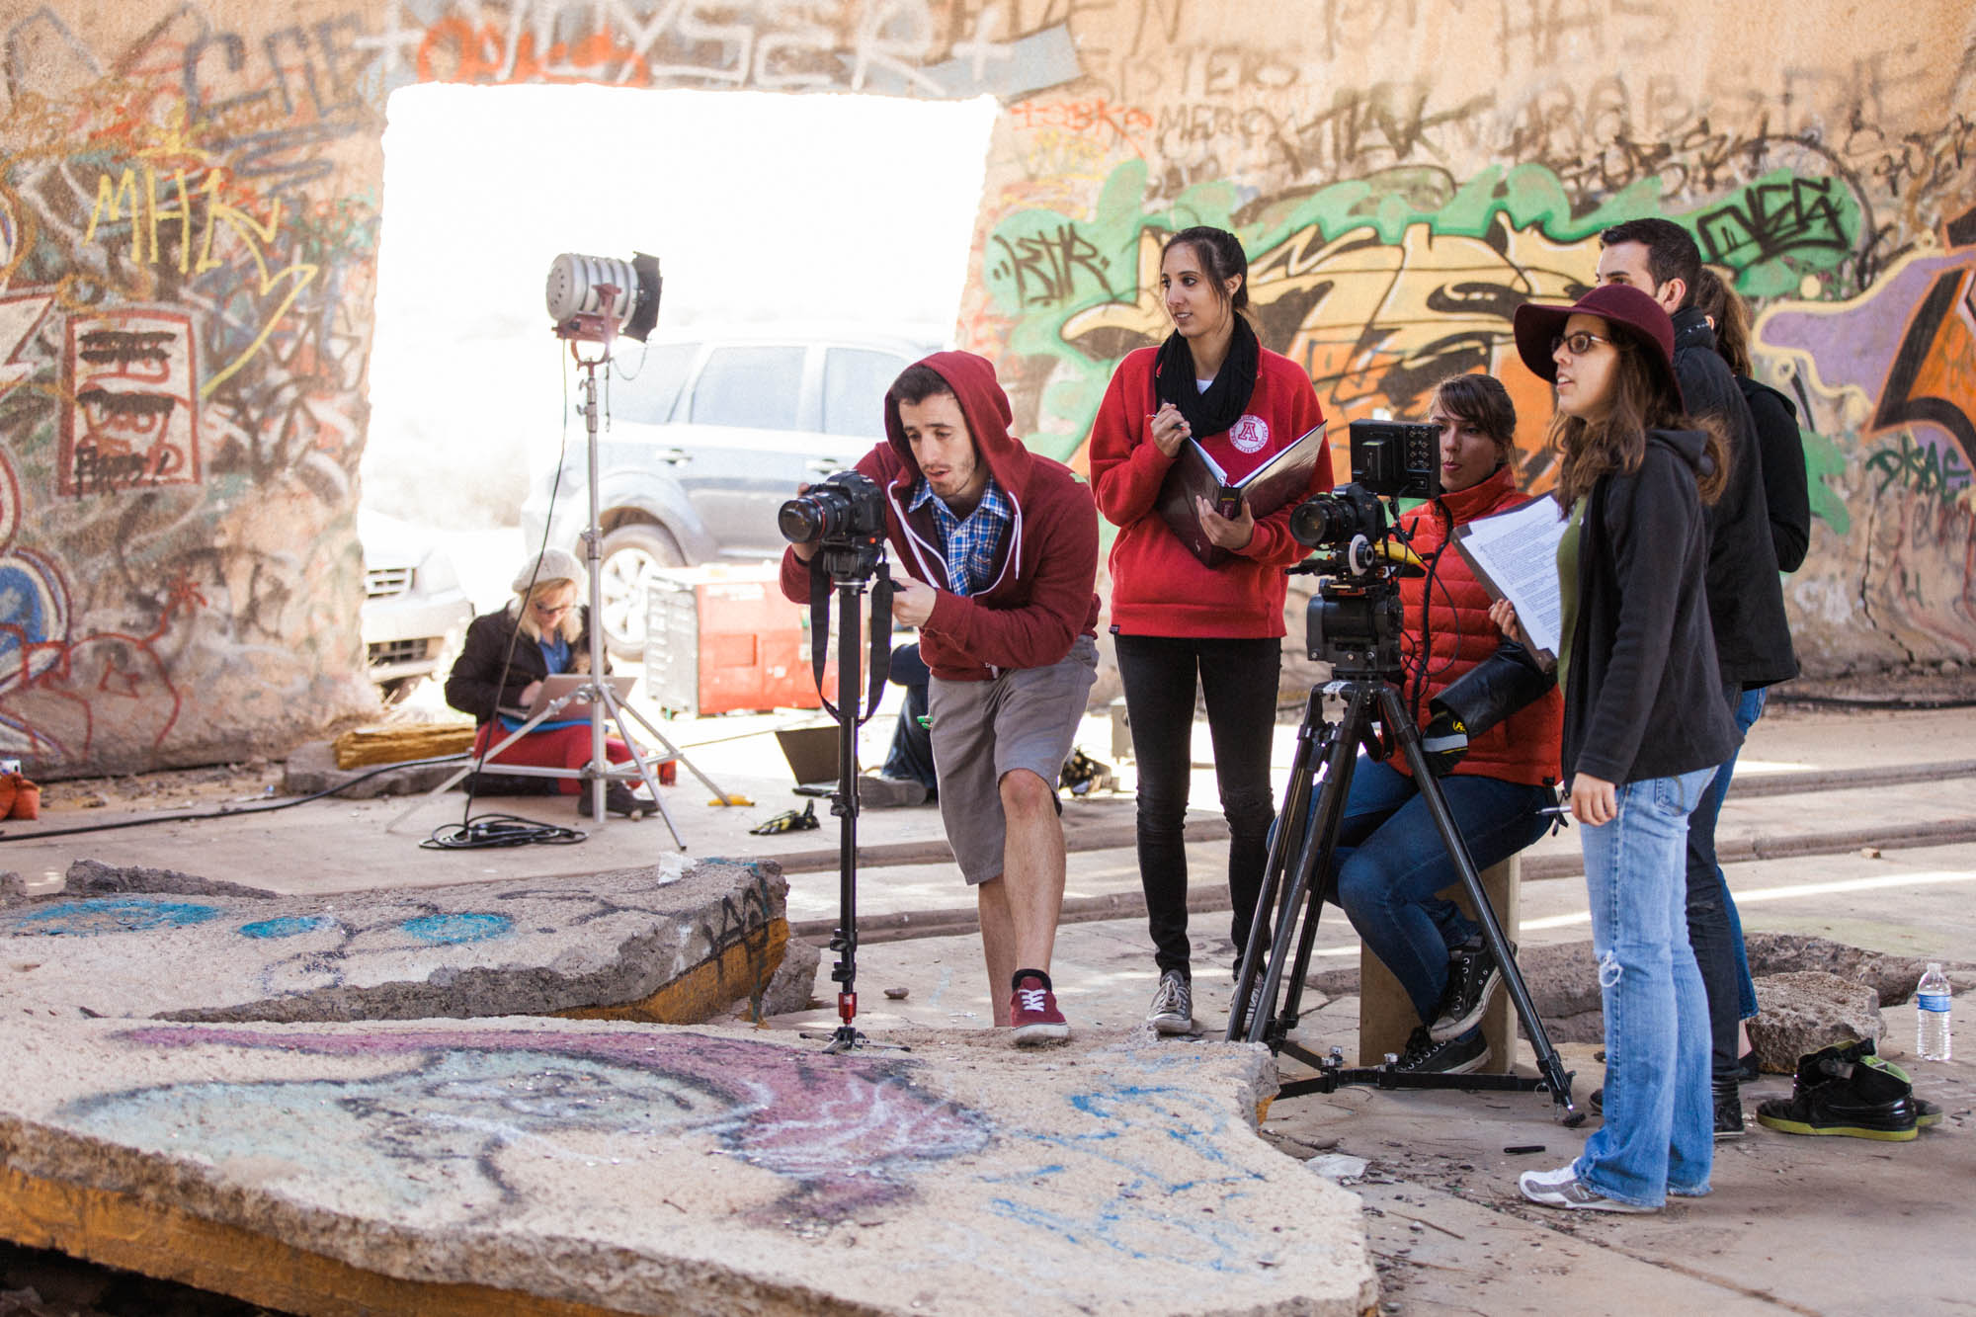
Internships
  Real-world experience, making real-world contacts
  Required for all Film & TV majors
  Prerequisites: Completion of all five FTV core courses and FTV 303 (the pre-internship course), and a 2.5 minimum overall GPA
  Internships may be in L.A., New York, Tucson, your hometown, etc.
  Most students complete internship during the summer before their senior year

Slide 11
The FTV Major Application includes:
  Statement of Intent
  Two Personal Insight Essays
  Letter of Recommendation
  Instructions will be given at the online application.
Application deadline: December 1, 2026
To be eligible to apply to the FTV major, you must have a minimum overall cumulative UA GPA of 2.5 (or be in your first semester at UA with no GPA yet).

Slide 12
FTV Major Application Instructions
(read carefully!)
  Submit an application online, using the “Slate” system, at:
  https://slate.admissions.arizona.edu/register/changeofmajorCFA
  Fill out the form, and select “BA – Film & Television” from the drop-down list. Click “Submit”.
  Within one business day after you have submitted the form, you will receive an email from UA Admissions. (If you don’t see this email at your UA email inbox, check your personal non-UA email address.) This email is notification that your Film & Television major application has been created,
  and it will give you your username for your application. Using the link provided in the email, log in, choose “Fine Arts Application”, and then follow the instructions in the system.
  We recommend you complete your application using a computer (not your phone).
  Questions? Contact Ms. Daniela Tascarella, at danielat1@arizona.edu or (520) 621-9303.

Slide 13
FTV Major Frequently Asked Questions
  Can I apply if my GPA is under a 2.5?
    If your GPA is close to a 2.5 (2.3 or 2.4) you may apply, but you must fill out the optional essay question to explain your low GPA.
    If your GPA is lower than the range listed above, your change of major application will not be created by Daniela Tascarella.
  Can I have a recommender that is not a teacher?
    Yes, as long as that person is not a family member or friend. You will also need to fill out the optional essay explaining why you are not having a teacher write on your behalf.
  Can I submit a portfolio?
    No, portfolios are required nor accepted.
  How long will it take to graduate?
    You will set up an advising appointment if you are admitted and your advisor will help come up with a plan to get you graduated in four years.

Slide 14
FTV Major Frequently Asked Questions Continued
  What can I minor in?
    You can minor in anything you would like.
  Can I double major instead of changing my major?
    Yes, the change of major form is still the same for double majoring. You will just need to let your advisor know you want to double major instead of change your major at your first appointment.
  Can I re-apply if I am not admitted?
    Yes, you can re-apply next semester. You can also get tips from a faculty member to improve your application.
  When will I hear from an advisor about making an appointment?
    You will hear from your advisor shortly after receiving an admissions decision, if admitted.
  For all other questions please email Daniela Tascarella at danielat1@arizona.edu.

Slide 15




